Slide 1

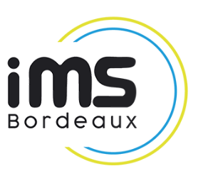
SWAP-C Ka-Band High Power Diplexer
Based on the Emerging AFSIW Technology
15-18 October 2024
ESA/ESTEC, Noordwijk, The Netherlands
Presented by : Dr. Issam MARAH

Slide 2
Outline
Introduction
Technological challenge and AFSIW
Diplexer Design
  Circulator
  Channels filters
  Demonstrator
Conclusion

Slide 3
Outline
Introduction
Technological challenge and AFSIW
Diplexer Design
  Circulator
  Channels filters
  Demonstrator
Conclusion

Slide 4

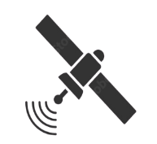







Introduction
Base Station
Downlink
Uplink
Users and Applications
Uplink
Downlink
Space Democratization
High Power
Small Size
SWaP-C
Low Cost
Low Weight

Slide 5
Motivation
Base Station
Downlink
Uplink
User and Application
Uplink
Downlink
The number of communication channels is constantly increasing
There is a real need for multiplexing systems
SWaP-C + Multiplexing = Motivation

Slide 6
Outline
Introduction
Technological challenge and AFSIW
Diplexer Design
  Circulator
  Channels filters
  Demonstrator
Conclusion

Slide 7
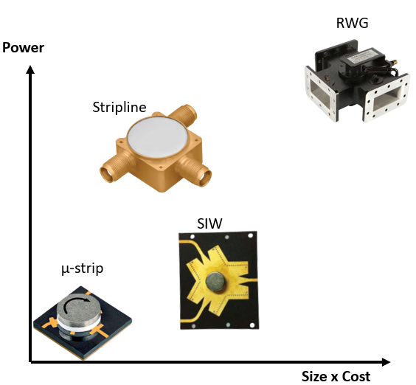
Technological Challenge
Will you marry me !?
YES !!!
2012
Waveguide
Planar/PCB
Power
Power
Size
Weight
Cost
Size
Weight
Cost
AFSIW
AFSIW (Air Filled Substrate Integrated Waveguide)

Slide 8
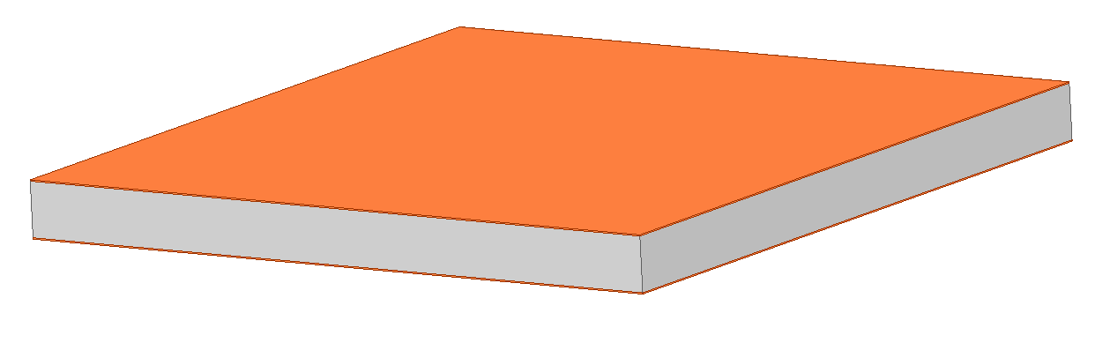
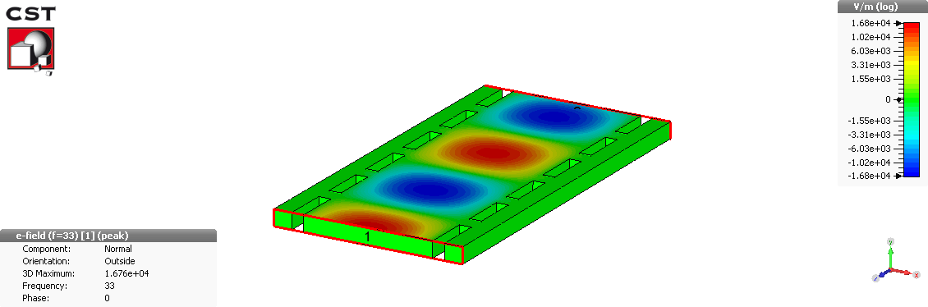
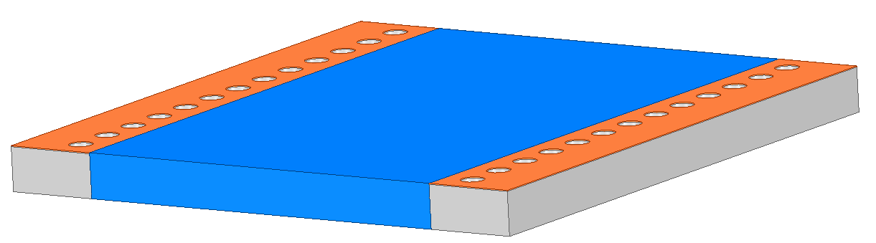

AFSIW transmission line
W₁
Substrat 3
W₂
Substrat 2
h
Substrat 1
Copper
Substrate
Air
AFSIW (Air Filled Substrate Integrated Waveguide)

Slide 9
Outline
Introduction
Technological challenge and AFSIW
Diplexer Design
  Circulator
  Channels filters
  Demonstrator
Conclusion

Slide 10
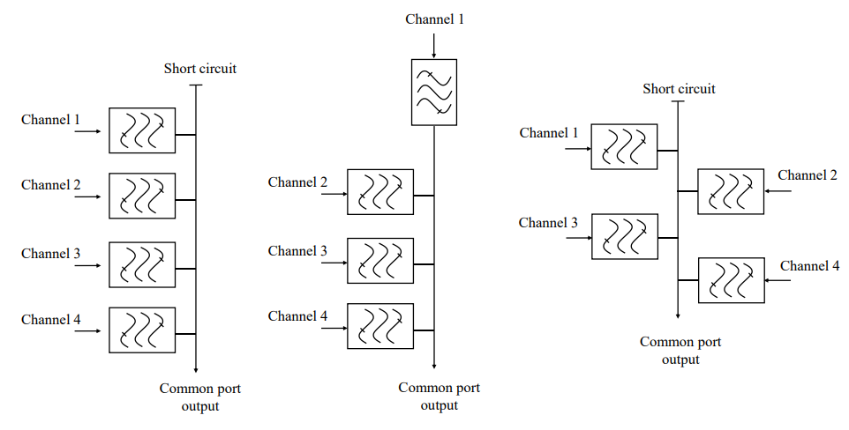
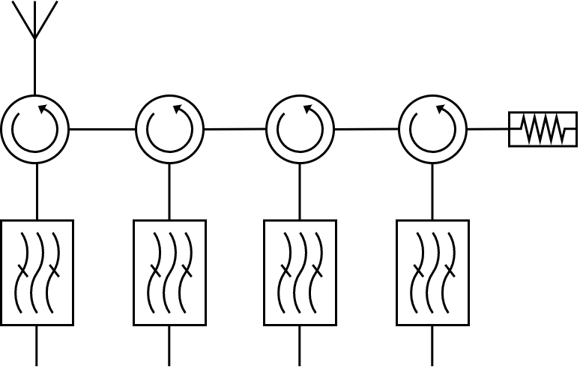
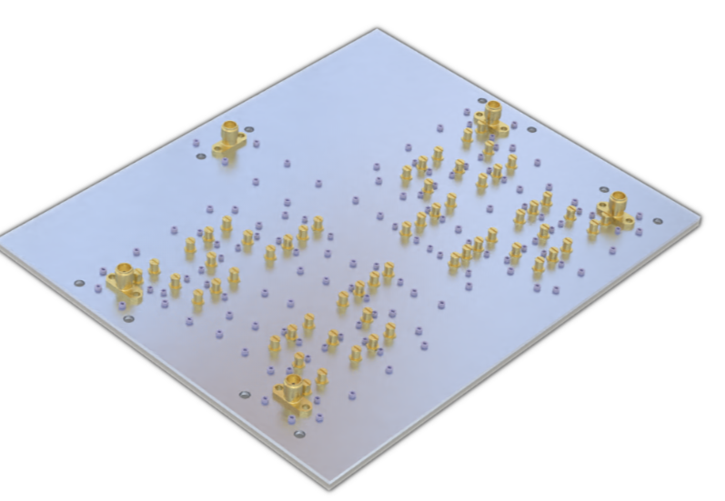
Multiplexing design
Manifold topology
Circulator topology
Commune
Addressed by ARTES ESA Cobham 2020
Commune
Channel 1
Channel 2
Compact solution
Low insertion loss
Low robustness solution
High design complexity
Bulk solution
High insertion loss
High robustness solution
Low design complexity

Slide 11
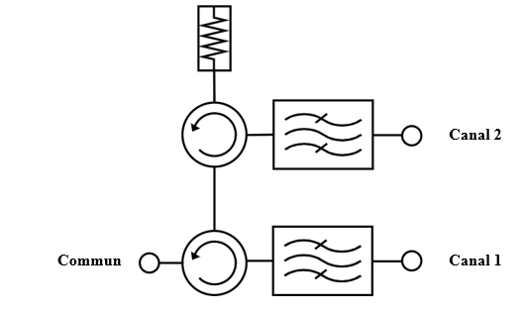
Outline
Introduction
Technological challenge and AFSIW
Diplexer Design
  Circulator
  Channels filters
  Demonstrator
Conclusion

Slide 12
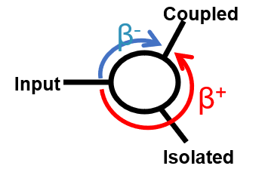
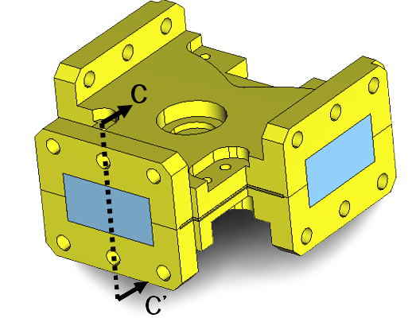
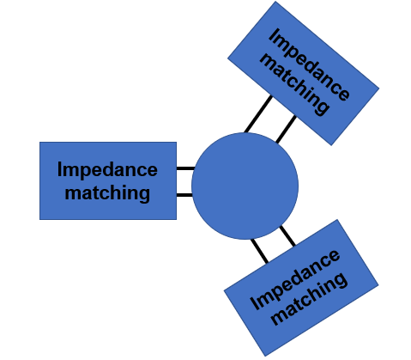
Circulator design
Waveguide Circulator
Thanks to ferrite
CC’ Cross section
Waveguide Ridge
Circulator
Ferrite
Metal Ridge

Slide 13

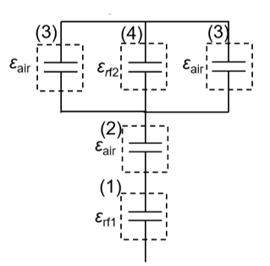
Circulator design
Waveguide to AFSIW
Reduced height
Multipactor risk
No standard PCB machining. Cost impact
Ferrite
Metal Ridge
Ferrite1
Ferrite2
(3)
(4)
(3)
Solution
(2)
(1)
Using ferrite for circulation and impedance matching
Ridge suppression
How can impedance matching be done?

Slide 14
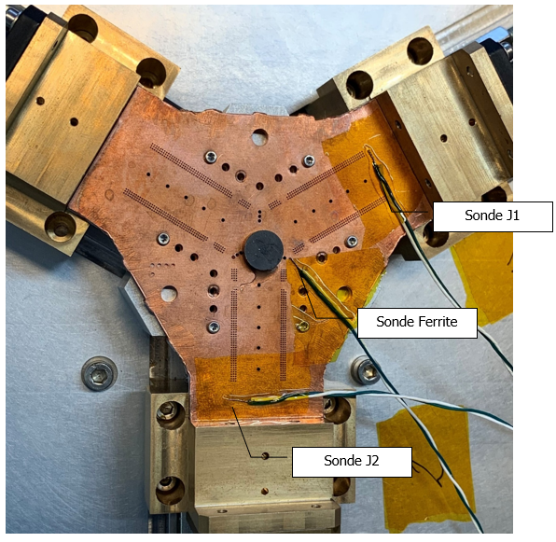
Circulator design
Good agreement between simulations and measurements
Frequency band: 17.3 – 22 GHz (over Ka band downlink)
Insertion loss: 0.3 dB maximum
Return loss: 23 dB minimum
Isolation: 25 dB minimum
Frequency (GHz)

Slide 15
Outline
Introduction
Technological challenge and AFSIW
Diplexer Design
  Circulator
  Channels filters
  Demonstrator
Conclusion

Slide 16
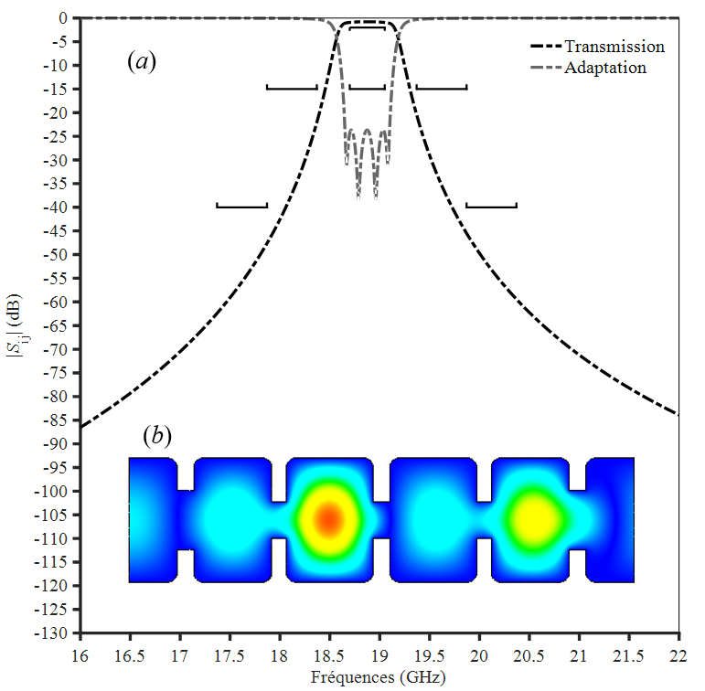
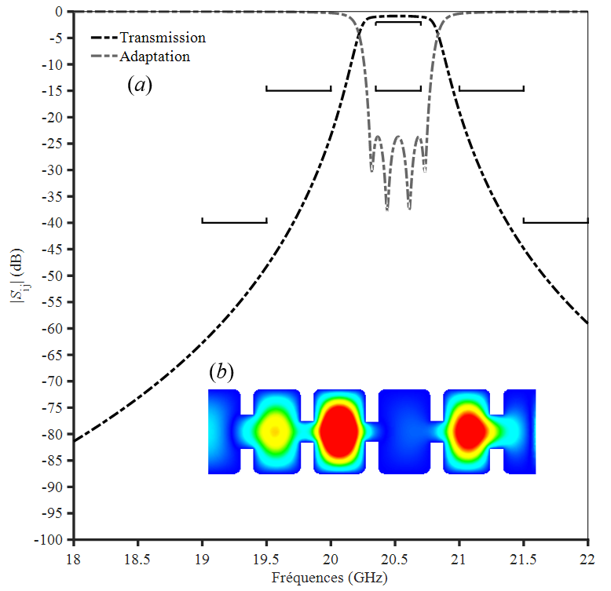
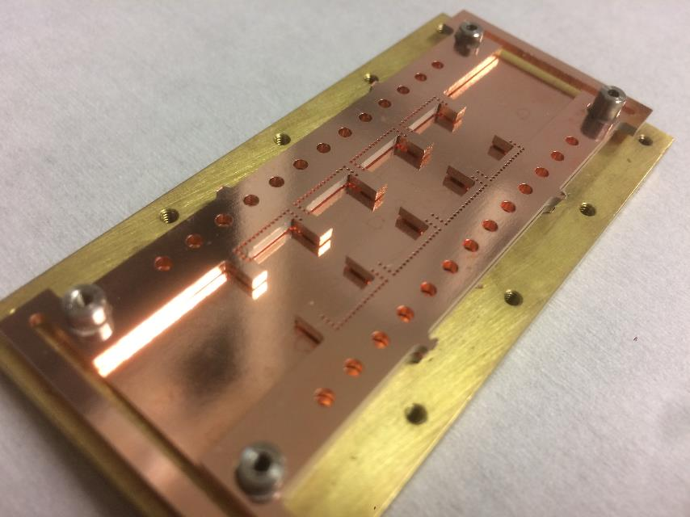
Channels filters design
Channel 1 ~19GHz
Channel 2 ~20.5GHz
Air rectangular cavity and Iris
Frequency (GHz)
Frequency (GHz)
4 poles filter is needed to meet the desired rejection
15dB @+/-500MHz and 40dB @+/-1000MHz

Slide 17
Outline
Introduction
Technological challenge and AFSIW
Diplexer Design
  Circulator
  Channel filter
  Demonstrator
Conclusion

Slide 18
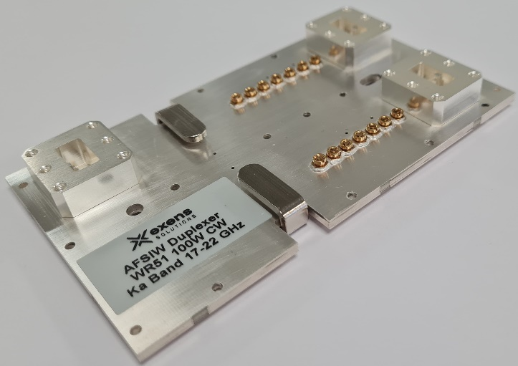
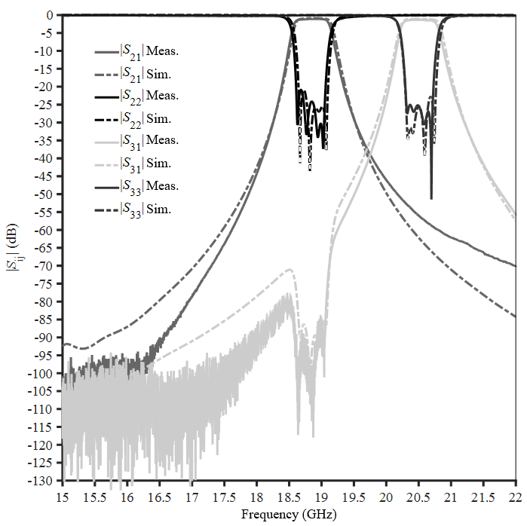
Diplexer Demonstrator
AFSIW Diplexer Demonstrator
Simulation vs measurement
Waveguide integrated interconnexion
Steel yoke for magnetic shielding
SmCo magnet for ferrite biasing
Tuning screw for filters tunning
Integrated high power absorbed load

Slide 19
Diplexer Demonstrator
Measurements after x100 cycles VRT
Channel 1
Frequency band: 18.7-19.05 GHz
Insertion loss: 1.4 dB max
Return loss: 22 dB min
Rejection @ +/- 500 MHz: 19 dB min
Rejection @ +/- 1000 MHz: 40 dB min
Channel 2
Frequency band: 20.37-20.7 GHz
Insertion loss: 1.69 dB max
Return loss: 18 dB min
Rejection @ +/- 500 MHz : 18 dB min
Rejection @ +/- 1000 MHz : 41 dB min

Slide 20
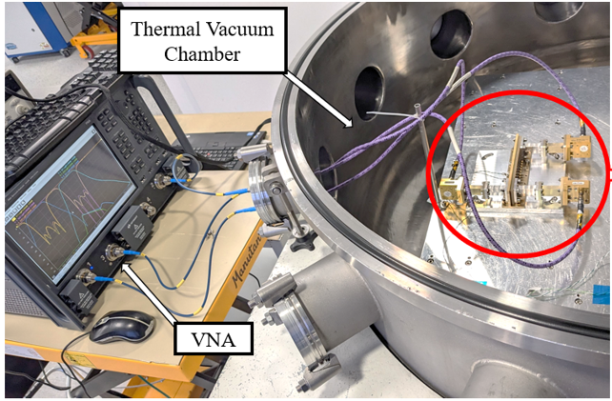
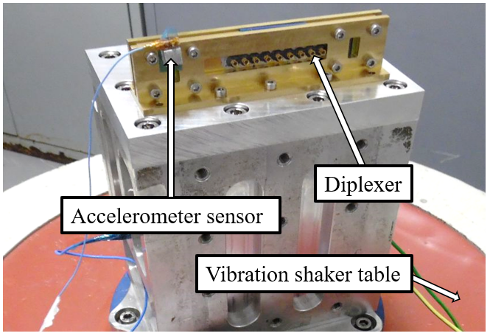
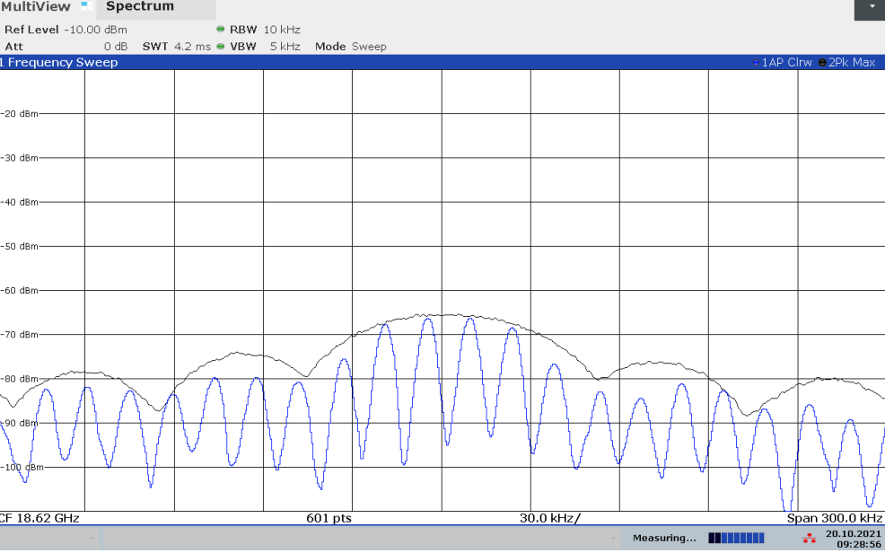
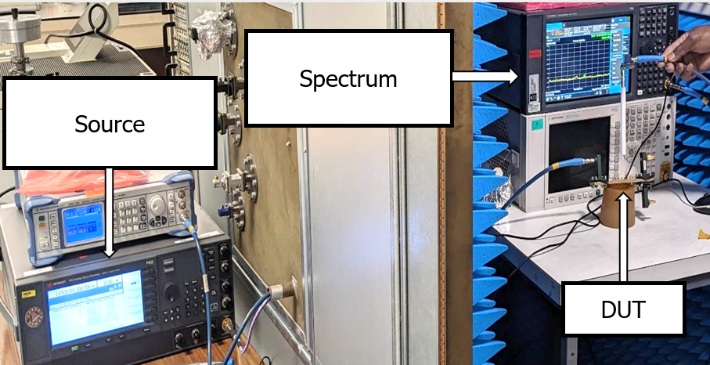
Additional Tests on Different AFSIW Boards
Power Handling and multipactor
up to 200W
Thermal Vacuum Cycling
X100 Cycles
Vibration Test
Sniff Test >80 dBi

Slide 21
Outline
Introduction
Technological challenge and AFSIW
Diplexer Design
  Circulator
  Channel filter
  Demonstrator
Conclusion

Slide 22
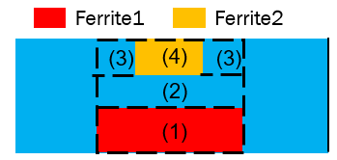
Conclusion
SWAP-C and technological Challenge are introduced
AFSIW trad-off between Power, Cost, Weight and Size is presented
Development of an innovative AFSIW circulator solution is detailed
Demonstrator of the integrated AFSIW Ka band diplexer is shown

Slide 23
Thank you for your attention
AFSIW Technology “Believes it Can Fly “

